Slide 1
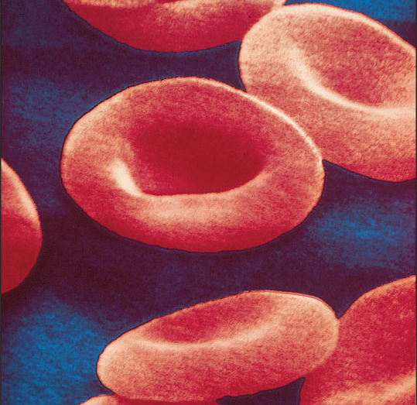
BLOOD
Check Your Recall
Check Your Recall
Pages 318 – 322
#s 1-5, 8 & 9

Slide 2
BLOOD
Table of Leukocytes
Design a table for the five leukocytes to include a diagram of the cell, general characteristics, and functions.
Leukocyte Name | Diagram | General Characteristics | Functions

Slide 3
BLOOD
Check Your Recall
Check Your Recall
Pages 325 - 335
#s 24 – 27 and 32 - 35

