Slide 1
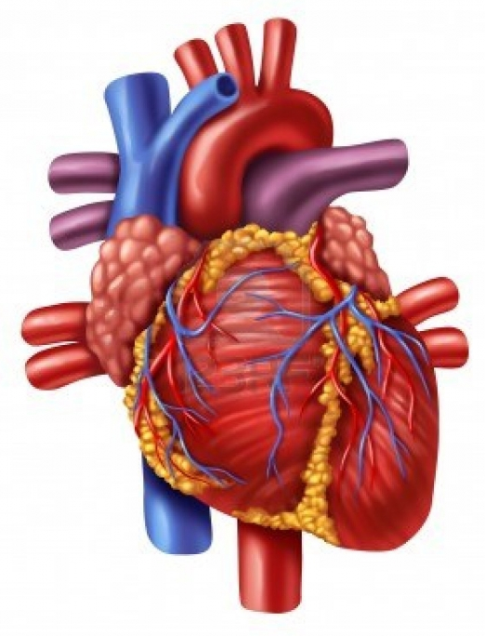
CARDIOVASCULAR SYSTEM HEART DIAGRAM
Draw a diagram of the heart to include the following:
Right & Left Atrium
Right & Left Ventricles
Septum
Coronary Arteries & Veins
Pulmonary Arteries & Veins
Superior & Inferior Vena Cavae
Aorta
Right & Left AV Valves
Pulmonary Valve
Aortic Valve
Purkinje Fibers
Chordae Tendonae
Visceral, Parietal, & Fibrous Pericardium
Epicardium, Myocardium & Endocardium

Slide 2
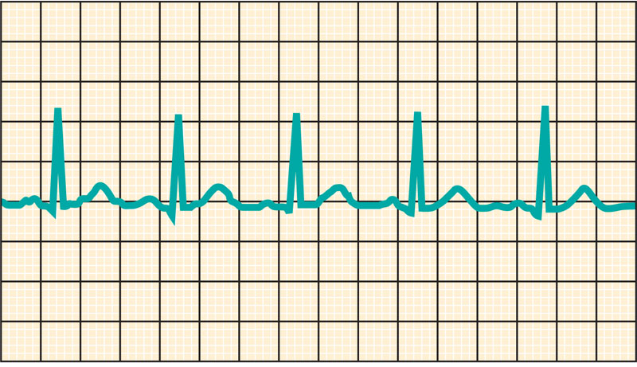
CARDIOVASCULAR SYSTEM CHECK YOUR RECALL
Check Your Recall
Pages 348 – 352
Questions 9, 13, 14, 16-19

Slide 3
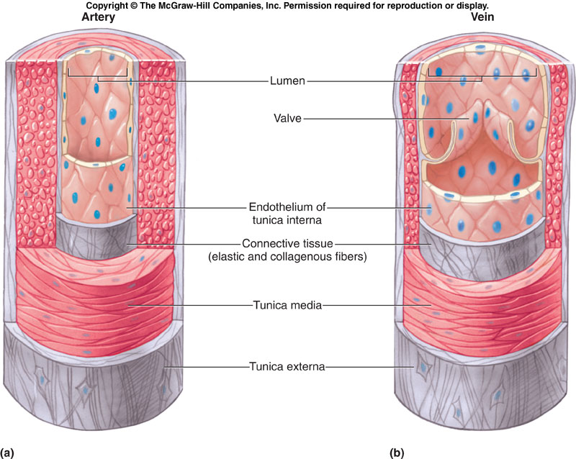
CARDIOVASCULAR SYSTEM CHECK YOUR RECALL
Check Your Recall
Pages 355 – 357
Questions 20 – 29

Slide 4
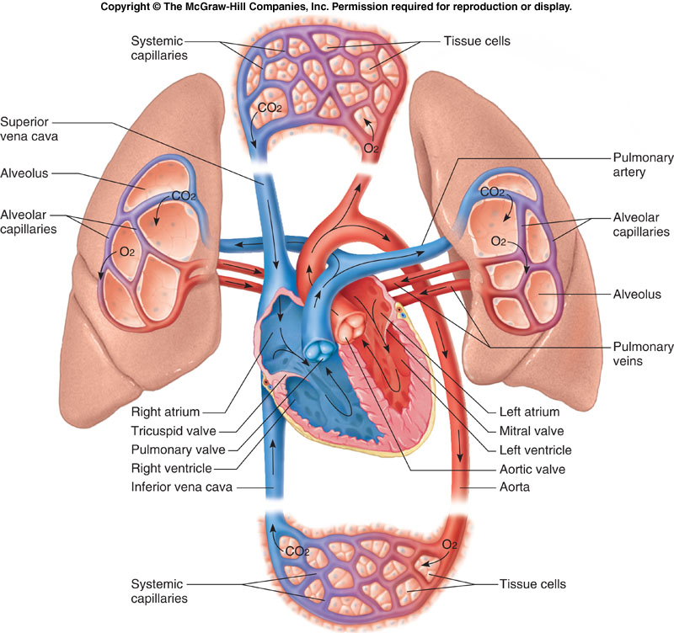
CARDIOVASCULAR SYSTEM CHECK YOUR RECALL
Check Your Recall
Pages 358 – 362
Questions 30 – 43

