Slide 1
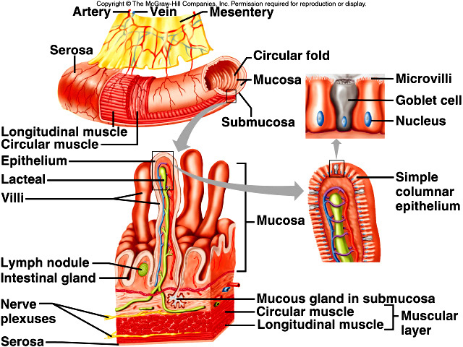
DIGESTIVE SYSTEM ALIMENTARY CANAL DIAGRAM
Draw and label the layers of the alimentary canal to include the following terms:
Mucosa
Submucosa
Circular muscle
Longitudinal muscle
Serosa
Mesentery
Lacteal
Villi
Blood vessels
Lymph vessels
Nerve plexuses

Slide 2
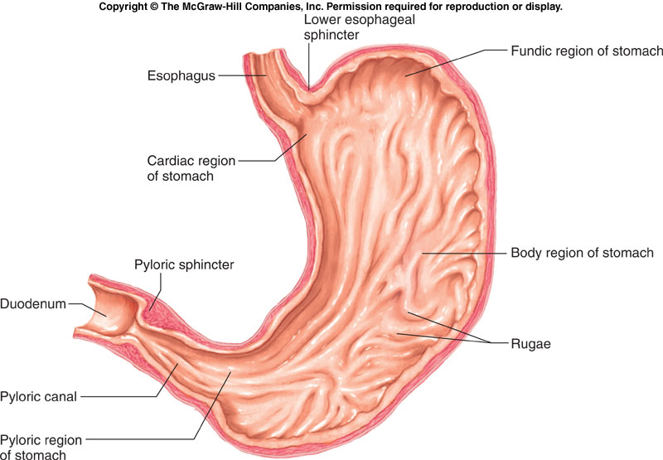
DIGESTIVE SYSTEM CHECK YOUR RECALL – Upper G.I. Tract
Check Your Recall
Page 409 – 414
Questions 9, 13 – 20

Slide 3
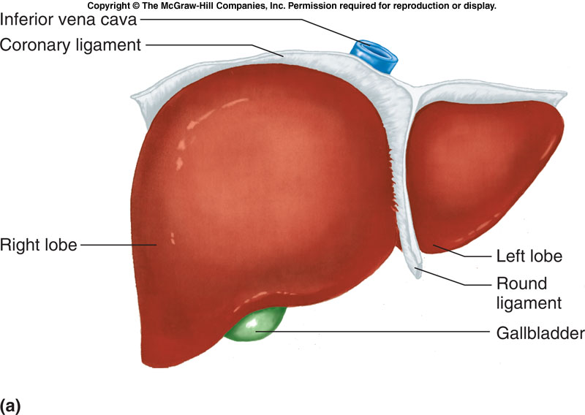
DIGESTIVE SYSTEM CHECK YOUR RECALL – Accessory Organs
Check Your Recall
Page 414 - 421
Questions 23, 24 & 28 – 32

Slide 4
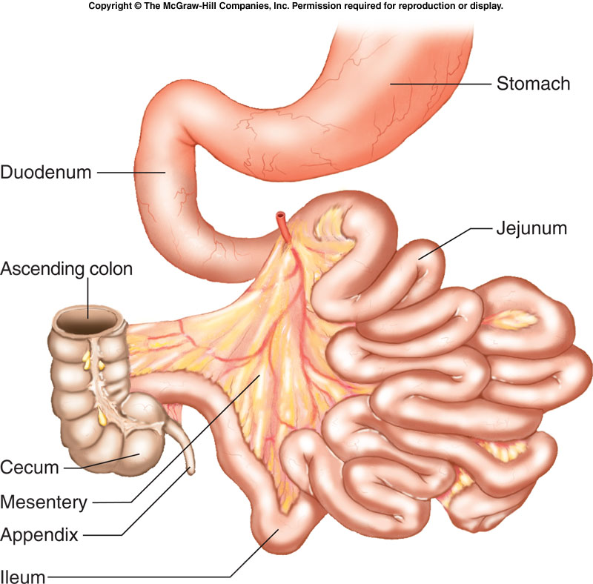
DIGESTIVE SYSTEM CHECK YOUR RECALL – Lower G.I. Tract
Check Your Recall
Page 421 – 429
Questions 34 – 38, 41, 43 – 45

Slide 5
DIGESTIVE SYSTEM Nutrients Chart
Complete the chart for carbohydrates, lipids and proteins providing the source of each, how they are utilized, and the body’s requirements.
Macromolecule | Source | Utilization | Requirements
Carbohydrates
Lipids
Proteins |  | X

