Slide 1
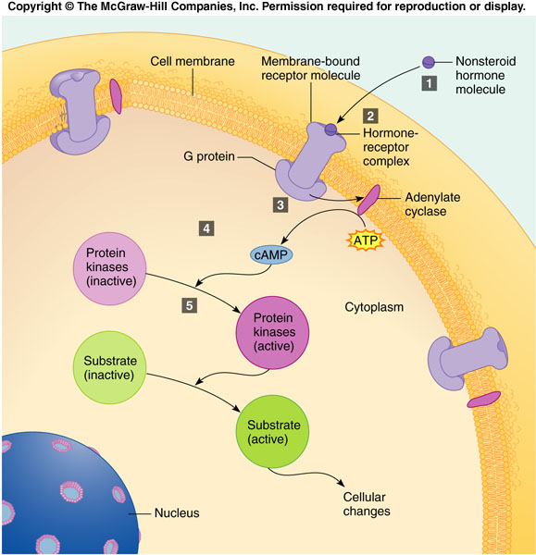
ENDOCRINE SYSTEM Intro – Check Your Recall
CHECK YOUR RECALL
Pages 290-295
Questions 4 – 7 and 9 - 12

Slide 2
ENDOCRINE SYSTEM THE PITUITARY GLAND (& Hypothalamus)
PART I: PITUITARY GLAND DIAGRAM
Draw a diagram of the pituitary gland to include the anterior pituitary, posterior pituitary, the capillary system, nerves from the hypothalamus, and the hypothalamus.
PART II: TABLE OF HORMONES
Make a table of the hormones of the pituitary gland and hypothalamus (12) to include the releasing organ (specify anterior/posterior if applicable), name of the hormone, and it’s general function.
Releasing Organ | Hormone Name | General Function(s)
Hypothalamus | Growth Hormone-Releasing Hormone | Increases the amount of GH the anterior pituitary to releases.
Hypothalamus | GH Release-Inhibiting Hormone | Inhibits the release of GH from the Anterior Pituitary.
Anterior Pituitary Gland | Growth Hormone (GH) | Stimulates body cells to grow and reproduce; speeds the rate of carb and fat usage.

Slide 3
ENDOCRINE SYSTEM THE THYROID & PARATHYROID GLANDS
PART I: THYROID & PARATHYROID GLANDS DIAGRAM
Draw a diagram of the thyroid and parathyroid glands.
PART II: TABLE OF HORMONES
Make a table of the hormones of the thyroid and parathyroid glands (4) to include the releasing organ, name of the hormone, and it’s general function.
Releasing Organ | Hormone Name | General Function(s)
Hypothalamus | Growth Hormone-Releasing Hormone | Increases the amount of GH the anterior pituitary to releases.
Hypothalamus | GH Release-Inhibiting Hormone | Inhibits the release of GH from the Anterior Pituitary.
Anterior Pituitary Gland | Growth Hormone (GH) | Stimulates body cells to grow and reproduce; speeds the rate of carb and fat usage.

Slide 4
ENDOCRINE SYSTEM The Adrenal Glands & Pancreas
PART I: ADRENAL GLANDS
Draw a diagram of the adrenal glands.
PART II: TABLE OF HORMONES
Make a table of the hormones of the adrenal glands and pancreas (6) to include the releasing organ (if applicable, specify if from the medulla or cortex), name of the hormone, and it’s general function.
Releasing Organ | Hormone Name | General Function(s)
Hypothalamus | Growth Hormone-Releasing Hormone | Increases the amount of GH the anterior pituitary to releases.
Hypothalamus | GH Release-Inhibiting Hormone | Inhibits the release of GH from the Anterior Pituitary.
Anterior Pituitary Gland | Growth Hormone (GH) | Stimulates body cells to grow and reproduce; speeds the rate of carb and fat usage.

Slide 5
ENDOCRINE SYSTEM Other ENDOCRINE ORGANS
TABLE OF HORMONES
Make a table of the hormones released by the pineal gland, thymus, and other organs associated with endocrine function (8) to include the releasing organ, name of the hormone, and it’s general function.
Releasing Organ | Hormone Name | General Function(s)
Hypothalamus | Growth Hormone-Releasing Hormone | Increases the amount of GH the anterior pituitary to releases.
Hypothalamus | GH Release-Inhibiting Hormone | Inhibits the release of GH from the Anterior Pituitary.
Anterior Pituitary Gland | Growth Hormone (GH) | Stimulates body cells to grow and reproduce; speeds the rate of carb and fat usage.

