Slide 1
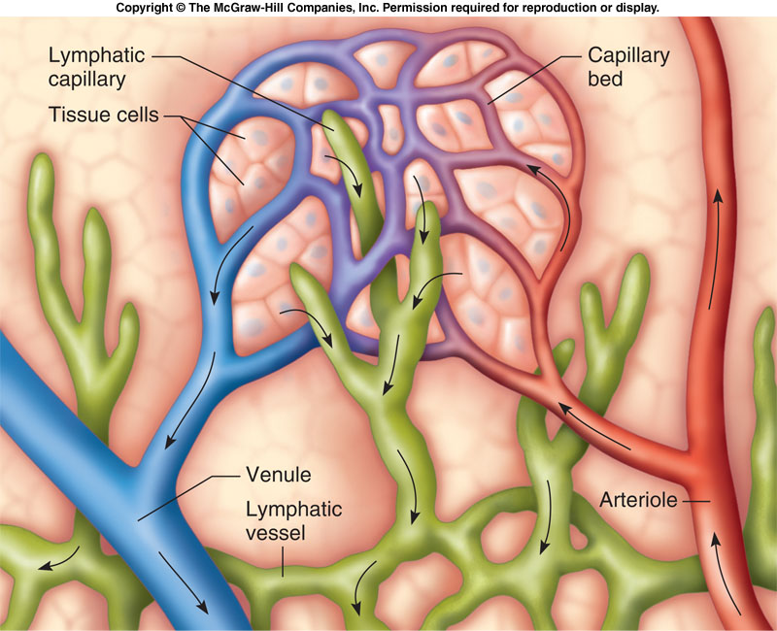
LYMPHATIC SYSTEM CHECK YOUR RECALL (LYMPHATIC SYSTEM INTRODUCTION)
CHECK YOUR RECALL
Pages 376 – 381
Questions 1 – 9

Slide 2
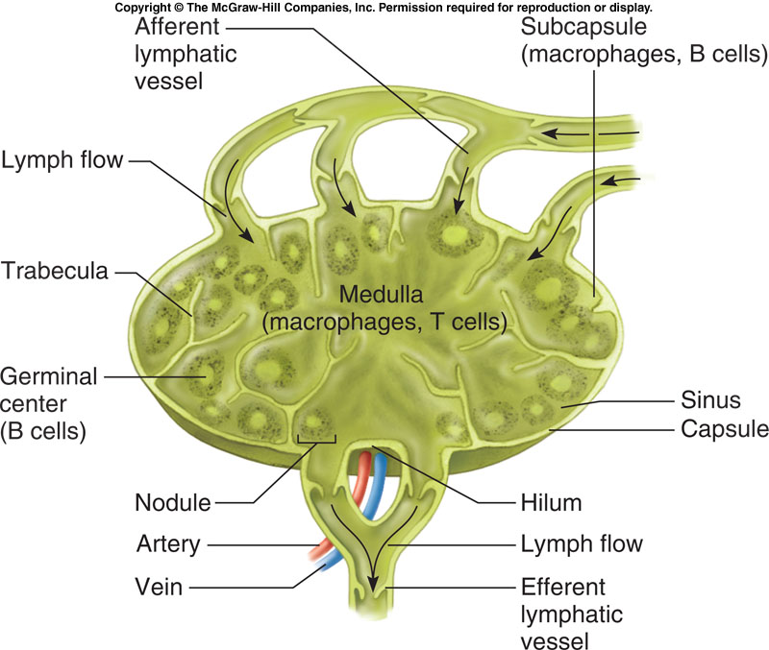
LYMPHATIC SYSTEM LYMPHATIC SYSTEM DIAGRAM
PART I: DIAGRAM OF FLUID MOVEMENT
Draw a capillary bed and diagram the movement of fluid from the capillary bed of the cardiovascular system into the interstitial space and lymphatic system.
PART II: LYMPH NODE DIAGRAM
Draw the lymph node and provide a brief paragraph describing it’s function.
Be sure to label all of the structural features of the lymph node.

Slide 3
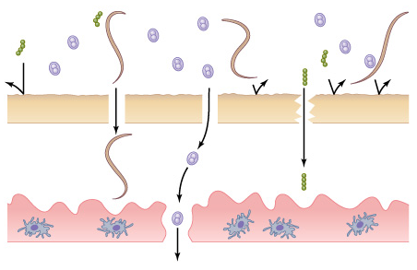
LYMPHATIC SYSTEM CHECK YOUR RECALL (Thymus, Spleen & Innate Defenses)
CHECK YOUR RECALL
Pages 381 – 385
Questions 10 – 13

Slide 4
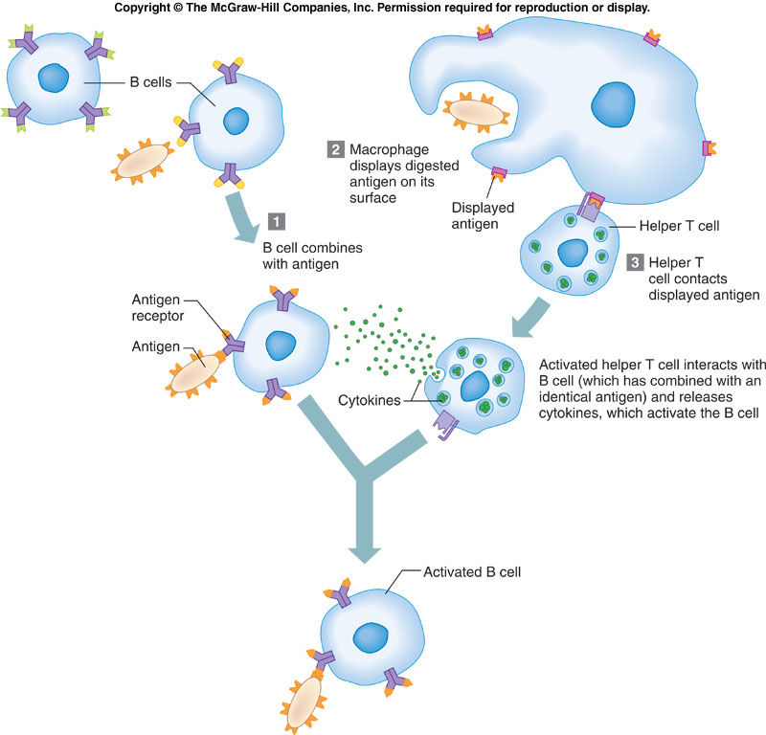
LYMPHATIC SYSTEM CHECK YOUR RECALL (Specific Defenses)
CHECK YOUR RECALL
Pages 388 – 391
# 17 – 26

