Slide 1
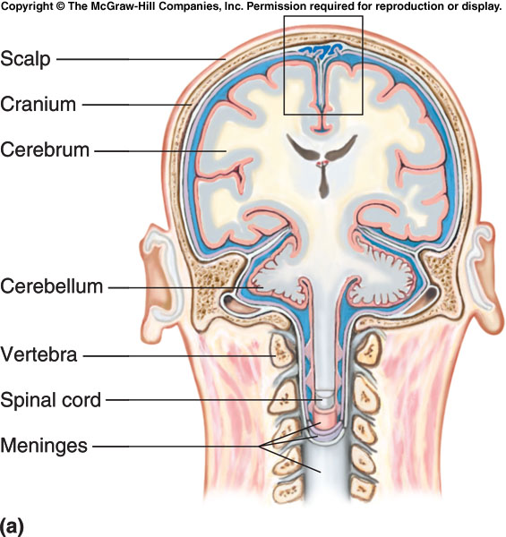
NERVOUS SYSTEM II Meninges & spinal cord Questions
Check Your Recall P. 230 – 233 Qs 31 - 35

Slide 2
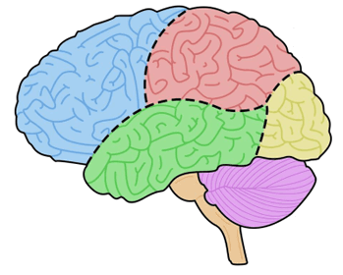
NERVOUS SYSTEM II BRAIN DIAGRAM
Draw, color, and label a diagram of the brain to include the parts listed below and the motor, sensory and association areas of the cerebral cortex:
Cerebrum
Diencephalon
Brainstem (Midbrain, Pons & Medulla Oblongata)
Cerebellum
Frontal Lobe
Temporal Lobe
Occipital Lobe
Parietal Lobe
Voluntary Motor Area
Concentration, Planning & Problem Solving
Auditory Control
Motor Speech (Broca’s Area)
Visual Area
Sensory Speech (Wernicke’s Area)
Visual/Auditory Pattern Memory

Slide 3
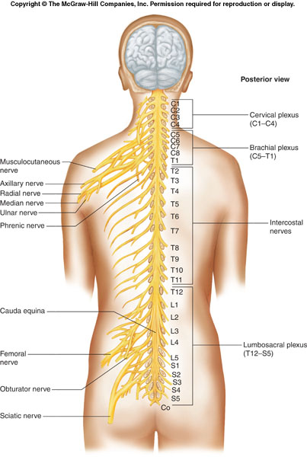
NERVOUS SYSTEM II PNS & ANS Questions
Check Your Recall P. 242 – 253 Qs 51-52, 54-55, 57-62

