Slide 1
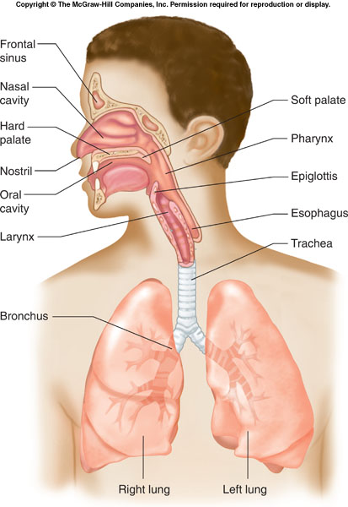
Respiratory System Respiratory System Diagram
Draw the respiratory system to include the following:
Nose
Nasal Cavity
Pharynx
Larynx
Epiglottis
Trachea
Bronchi
Lungs
Describe what occurs as air passes through the parts of the respiratory tract.

Slide 2
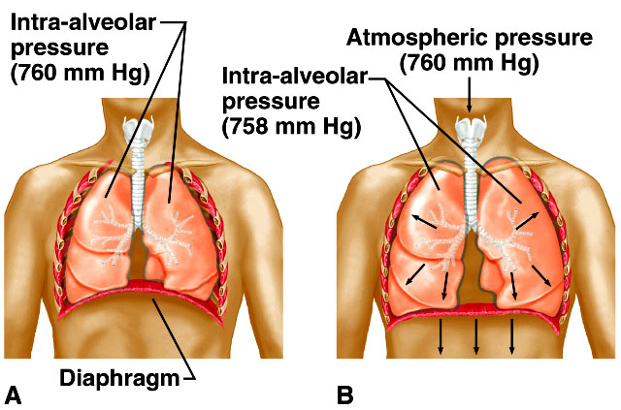
Respiratory System Check Your Recall – Breathing Mechanism
Check Your Recall
Pages 452 – 457
Questions 15 – 21

Slide 3
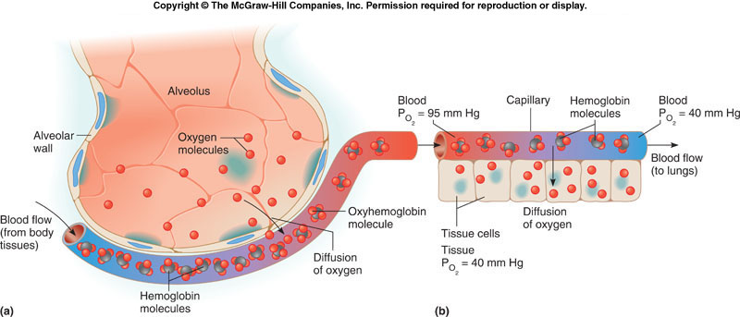
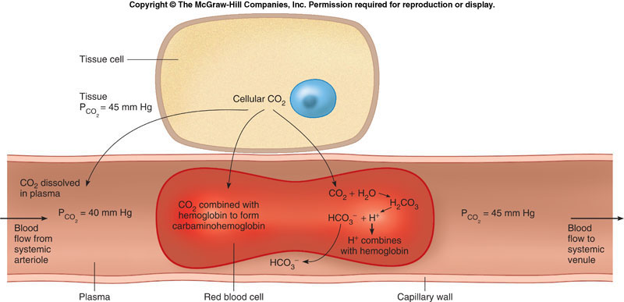
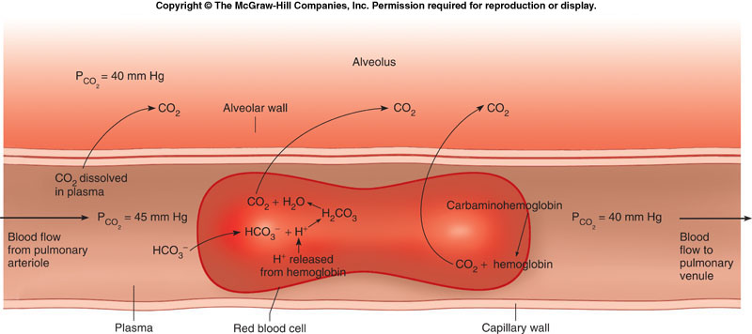
Respiratory System Gas exchange Diagram
Draw a diagram representing the process of respiration, to include:
Alveolar gas exchange
Transport of gases
Cellular respiration

