Slide 1
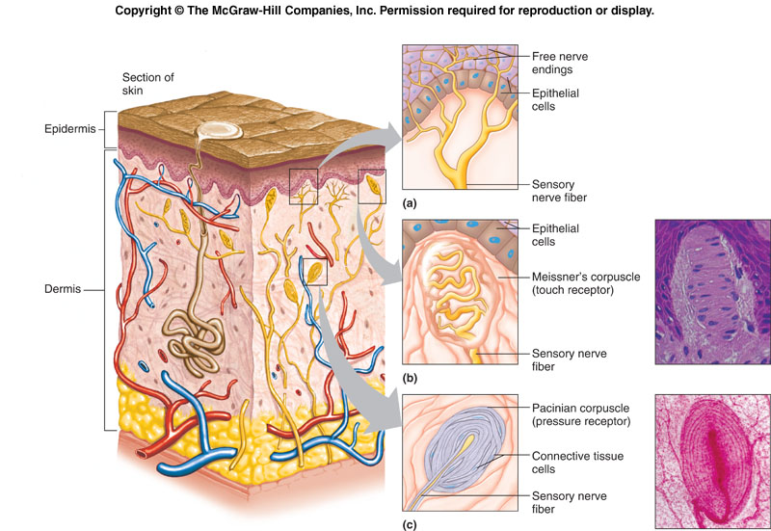
Somatic & Special Senses Activities
Nerve Receptors Diagram

Slide 2
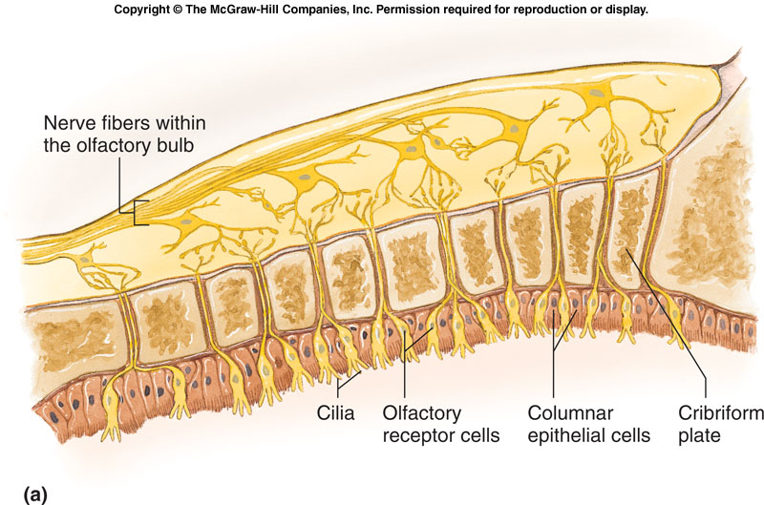
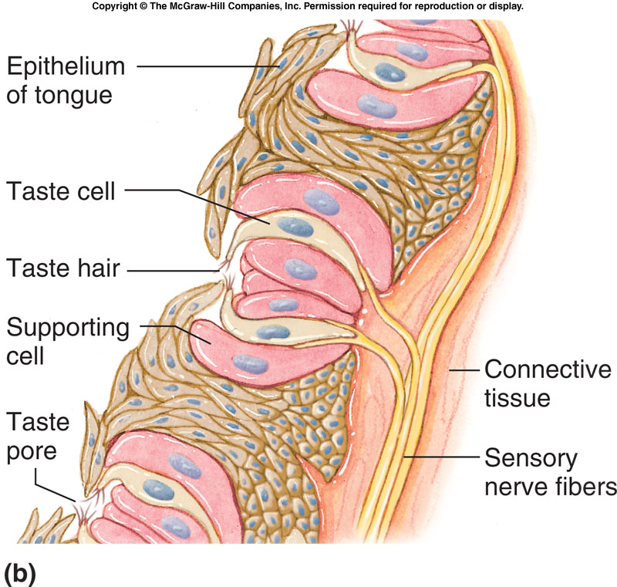
Somatic & Special Senses Activities Olfactory & Taste Diagram

Slide 3
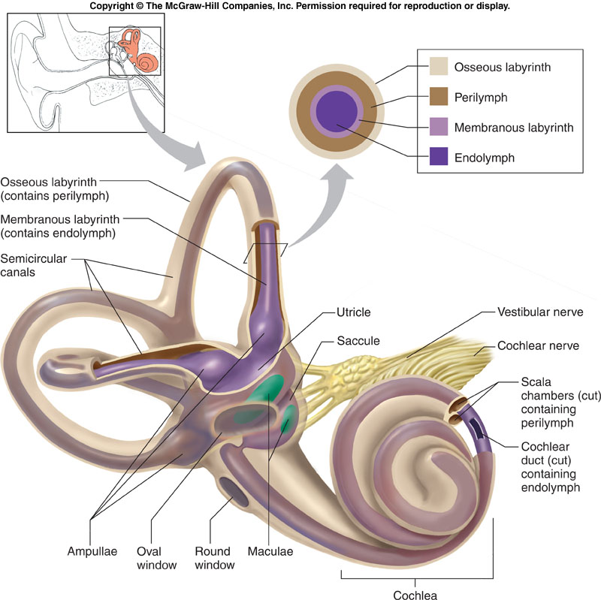
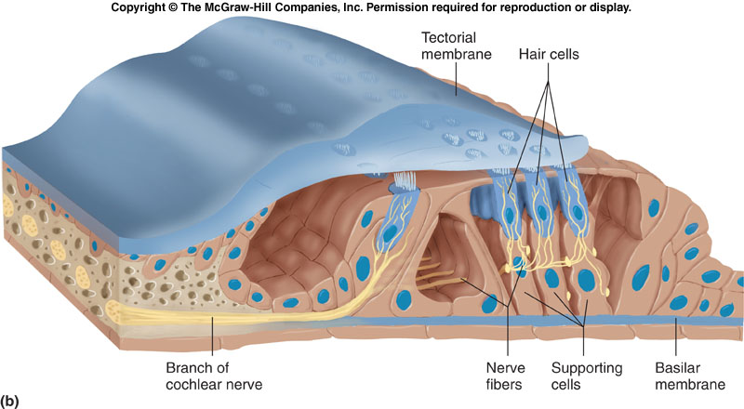
Somatic & Special Senses Activities
Inner Ear & Organ of Corti Diagram

Slide 4
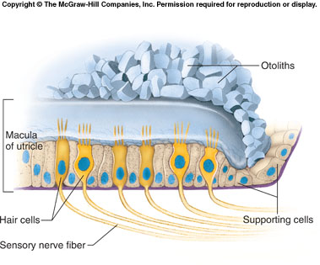
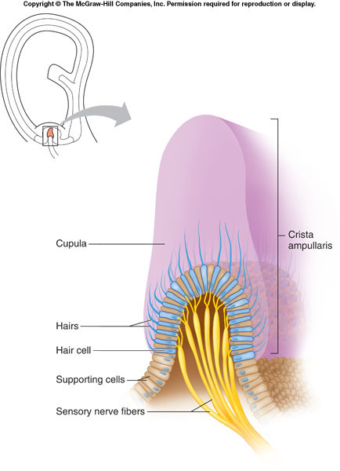
Somatic & Special Senses Activities Organs of Equilibrium Diagram

Slide 5
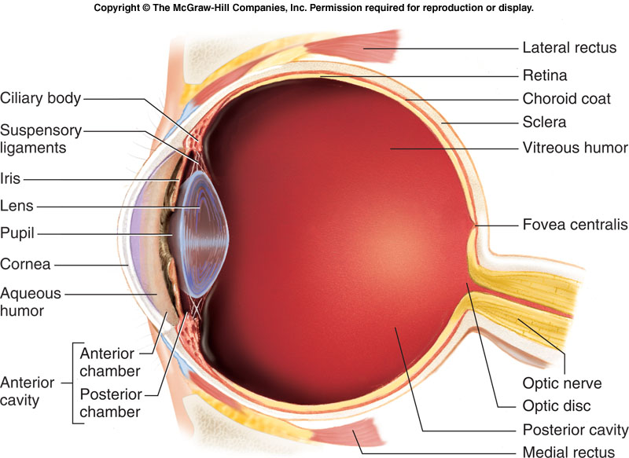
Somatic & Special Senses Activities
Eye Diagram

Slide 6
Somatic & Special Senses Activities
Check Your Recall
Check Your Recall
Page 282 #s 33 - 37

