Slide 1
Table of Tissues (Epithelial Tissue - Part 1)
Design and fill in a table of the tissues of the human body. Include the name of the tissue, type, a drawing, description of the tissue, and its general associated functions.
TISSUE | TYPE | DRAWING | DESCRIPTION | FUNCTIONS
Simple Squamous Epithelium | Epithelial |  | Single-layered Thin, flattened cells | Diffusion
EPITHELIAL TISSUES: (1) simple squamous epithelium, (2) simple cuboidal epithelium, (3) simple columnar epithelium, (4) pseudostratified columnar epithelium

Slide 2
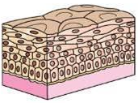
Table of Tissues (Epithelial Tissue - Part 2)
Design and fill in a table of the tissues of the human body. Include the name of the tissue, type, a drawing, description of the tissue, and its general associated functions.
TISSUE | TYPE | DRAWING | DESCRIPTION | FUNCTIONS
Stratified squamous epithelium | Epithelial |  | Multiple layers Thin, flattened cells | Protects underlying layers, may keratinize
EPITHELIAL TISSUES: (5) stratified squamous epithelium, (6) stratified cuboidal epithelium, (7) stratified columnar epithelium, (8) transitional epithelium, (9) holocrine glandular epithelium, (10) apocrine glandular epithelium, (11) merocrine glandular epithelium

Slide 3
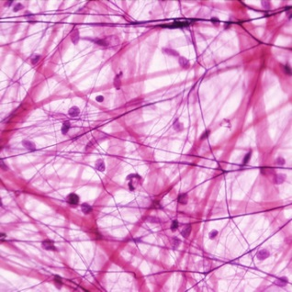
Table of Tissues (Connective Tissue)
Design and fill in a table of the tissues of the human body. Include the name of the tissue, type, a drawing, description of the tissue, and its general associated functions.
TISSUE | TYPE | DRAWING | DESCRIPTION | FUNCTIONS
Areolar tissue | Connective |  | Contains fibroblasts, elastic and collagenous fibers, and gel-like ground substance | Binds tissues and organs together
CONNECTIVE TISSUES: (1) Loose connective (areolar) tissue, (2) Adipose tissue, (3) Dense connective tissue, (4) Hyaline cartilage, (5) Elastic cartilage, (6) Fibrocartilage, (7) Bone, (8) Blood

Slide 4
Table of Tissues (Muscular & Nervous Tissue)
Design and fill in a table of the tissues of the human body. Include the name of the tissue, type, a drawing, description of the tissue, and its general associated functions.
TISSUE | TYPE | DRAWING | DESCRIPTION | FUNCTIONS
Smooth muscle tissue | Muscular |  | Spindle-shaped, uni-nucleated, lacks striations | Lines walls of internal organs
MUSCULAR TISSUES: (1) skeletal muscle tissue, (2) cardiac muscle tissue, (3) smooth muscle tissue
NERVOUS TISSUE

